Slide 1
CMSC201 Computer Science I for Majors Lecture 14 – For Loops

Slide 2
Last Class We Covered
Modularity
Meaning
Benefits
Program design
Top Down Design
Top Down Implementation
Bottom Up Implementation
#TBT
2 Dimensional lists

Slide 3
Any Questions from Last Time?

Slide 4
Today’s Objectives
To learn about the range() function
To learn about and be able to use a for loop
To understand the syntax of a for loop
To be able to combine range() and for
To discuss the differences between for loops and while loops

Slide 5
The range() function

Slide 6
Range of Numbers
Python has a built-in function called range() that can generate a list of numbers
ex = list(range(0, 10))
print(ex)
cast it to a list to force it generate the numbers now
like slicing – it’s UP TO (but not including) 10
[0, 1, 2, 3, 4, 5, 6, 7, 8, 9]

Slide 7
Syntax of range()
range(start, stop, step)
the number we want to start counting at
how much we want to count by
the number we want to count UP TO (but will not include)
the name of the function

Slide 8
Examples of range()
There are three ways we can use range()
With one number
range(10)
With two numbers
range(10, 20)
With three numbers
range(10, 20, 2)

Slide 9
range() with One Number
If range() is given only one number
It will start counting at 0
And will count up to (but not including) that number
Incrementing by one
list(range(4))
[0, 1, 2, 3]

Slide 10
range() with Two Numbers
If we give it two numbers, it will count from the first number up to the second number
list(range(5, 10))
list(range(10, 5))
[5, 6, 7, 8, 9]
[ ]
range() counts up by default!

Slide 11
range() with Two Numbers
If we give it two numbers, it will count from the first number up to the second number
list(range(-10, -5))
[-10, -9, -8, -7, -6]
from a lower to a higher number

Slide 12
range() with Three Numbers
If we give it three numbers, it will count from the first number up to the second number, and it will do so in steps of the third number
list(range(2, 11, 2))
list(range(3, 28, 5))
[2, 4, 6, 8, 10]
[3, 8, 13, 18, 23]
range() starts counting at the first number!

Slide 13
Counting Down with range()
By default, range() counts up
But we can change this behavior
If the STEP is set to a negative number, then range() can be used to count down
list(range(10, 0, -1))
[10, 9, 8, 7, 6, 5, 4, 3, 2, 1]

Slide 14
for Loops: Iterating over a List

Slide 15
Iterating Through Lists
Iteration is when we move through a list, one element at a time
Iteration is best completed with a loop
We did this previously with our while loop
Using a for loop will make our code much faster and easier to write
Even faster than the while loop was to write!

Slide 16
for Loops vs while Loops
With a while loop, infinite loops are a common problem
The programmer is in charge of updating the loop variable, and can easily forget
With for loops, infinite loops won’t happen
The loop variable is updated by Python
It’s handled “for” you!

Slide 17
Using range() in for Loops
We can use the range() function to control a loop through “counting”
for i in range(0, 20):
print(i + 1)
What will this code do?
Print the numbers 1 through 20 on separate lines
The for loop is iterating over the numbers

Slide 18
Using range() in for Loops
When we use the range() function in for loops, we don’t need to cast it to a list
The for loop handles that for us
print("Counting by fives...")
for num in range(5, 26, 5):
print(num)
5
10
15
20
25
call the range() function, but don’t need to cast it to a list

Slide 19
Using for Loops with Lists

Slide 20
Using a for Loop with Lists
We can combine a simple for loop with a list and the range() function, as shown below
for i in range( len(theList) ):
print( theList[i] )
What’s the benefit to doing it this way?
Why do we need range() and len()?
We’ll answer these questions momentarily

Slide 21
Breaking It All Down
If theList has a length of 8, what list does the range() in the for loop generate?
for i in range( len(theList) ):
print( theList[i] )
It will generate a list [0,1,2,3,4,5,6,7]
What does this represent?
The indexes of the list theList

Slide 22
Why range() and len()?
Why do we need len()?
To know how many indexes the list has
It will give us an integer value
Why do we need range()?
To generate all the indexes of the list
What does range() do with one number?
Start at 0, and count up to the number given

Slide 23
Common Error
Pay attention with len() and range()
Which goes on the outside?
range()
It needs the length to generate the indexes
If you use them backwards:
TypeError: 'list' object cannot be interpreted as an integer

Slide 24
Time for…
LIVECODING!!!

Slide 25
Running a Kennel
You are running a kennel with space for 5 dogs
You ask your 3 assistants to do the following, using the list of dogs in your office:
Tell you all of the dogs in the kennel
Tell you what pen number each dog is in
Later, all the dogs have been picked up, and someone dropped off their 5 German Shepherds, so the list in your office needs to be updated

Slide 26
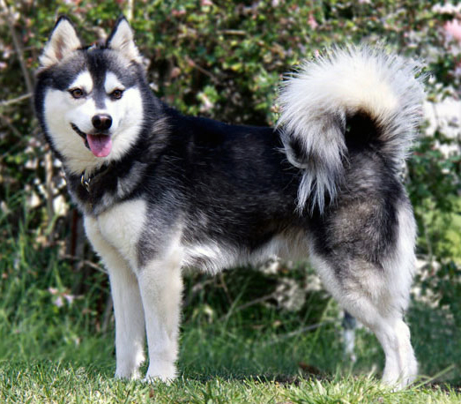
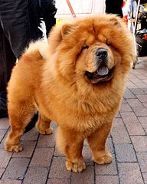
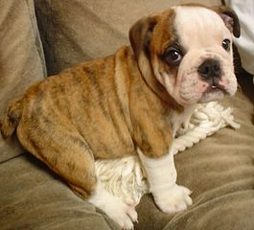
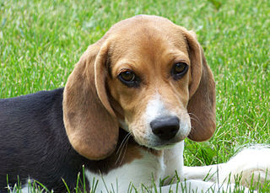
Running a Kennel
The dogs in your kennel at the start are:
Alaskan Klee Kai | Beagle | Chow Chow | Doberman | English Bulldog

Slide 27
Kennel Sample Output
Assistant #1:
Alaskan Klee Kai
Beagle
Chow Chow
Doberman
English Bulldog
Assistant #2:
There is a Alaskan Klee Kai in kennel pen 0
There is a Beagle in kennel pen 1
There is a Chow Chow in kennel pen 2
There is a Doberman in kennel pen 3
There is a English Bulldog in kennel pen 4
Assistant #3:
At the end of the day:
German Shepherd
German Shepherd
German Shepherd
German Shepherd
German Shepherd

Slide 28
Using Loops to Make 2D Lists
The easiest way to create a 2D list is to ...?
Start with an empty one-dimensional list
Create the first “row” as a separate list
Append it to the original 1D list
Repeat until all rows are added to the list
You can use a while loop, but for loops are great at creating lists of a specific size

Slide 29
Example: Creating 2D List
Create a 6-high by 4-wide list of underscores
board = []
row = []
for i in range(4):
row.append("_")
for i in range(6):
board.append( row[:] )
why is this here?
each row needs to be individual, hence it needs to be deep copied

Slide 30
Example: Creating 2D List from Input
Create a list of names and majors for 5 students
info = []
for i in range(5):
name = input("Enter name: ")
major = input("Major? ")
row = [name, major]
info.append(row)
why doesn’t this row need to be deep copied?

Slide 31
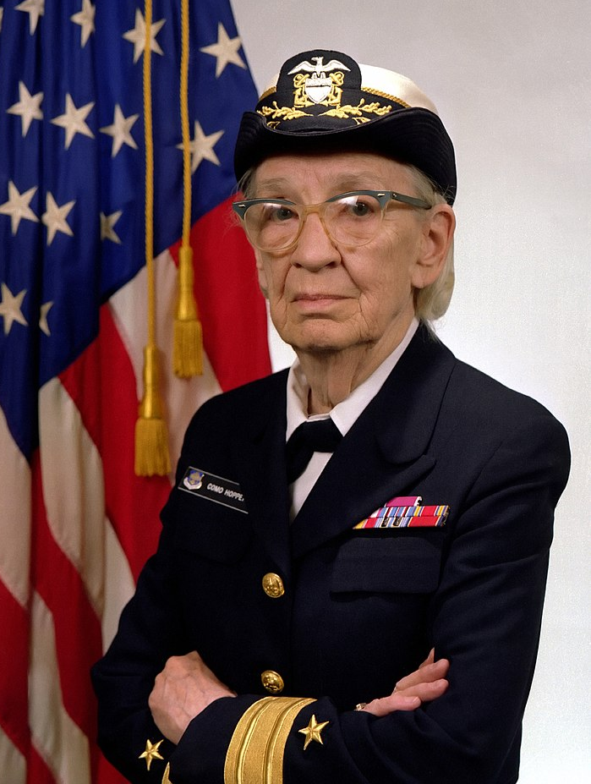
Daily CS History
Grace Hopper
Popularized the term “computer bug”
Invented the COBOL language
Invented one of the first compilers
US Navy Rear Admiral
Retired at the age of 79

Slide 32
Announcement: Advising
CMSC and CMPE students, sign up for an advising appointment.
http://advising.coeit.umbc.edu/registration/
Select that you are in MATH 150 or higher and haven't completed the gateway.
There are both group advising and individual advising appointments open. The earliest dates available are for group advising.

Slide 33
Announcements
Project 2 is out on Blackboard now
Design is due by Friday (Nov 3rd) at 8:59:59 PM
Design is entirely up to you, so think about it carefully!
Project is due by Friday (Nov 10th) at 8:59:59 PM
Final exam is Friday, December 15th from 6 to 8 PM

Slide 34
Image Sources
Rollercoaster:
https://commons.wikimedia.org/wiki/File:Corkscrew_(Cedar_Point)_01.jpg
Dog images:
https://commons.wikimedia.org/wiki/File:WOWAKK-Kukai-Alaskan-Klee-Kai.jpg
https://commons.wikimedia.org/wiki/File:Cute_beagle_puppy_lilly.jpg
https://commons.wikimedia.org/wiki/File:01_Chow_Chow.jpg
https://commons.wikimedia.org/wiki/File:Dobermannwurf.jpg
https://commons.wikimedia.org/wiki/File:English_Bulldog_puppy.jpg
Grace Hopper (adapted from):
https://en.wikipedia.org/wiki/File:Commodore_Grace_M._Hopper,_USN_(covered).jpg

